Slide 1
Multimedia Systems
Dr. Muazzam A. Khan

Slide 2
Multimedia Systems
What is Multimedia
Compression Techniques
Requirements of Multimedia Kernels
CPU Scheduling
Disk Scheduling
Network Management

Slide 3
What is Multimedia?
Multimedia data includes
- Audio and video clips (i.e. MP3 and MPEG files)
- Live webcasts
Multimedia data may be delivered to
- Desktop PC’s
- Handheld devices (PDAs, smart phones)

Slide 4
Introduction
"A distributed multimedia system (DMS) is an integrated computing communication and information system that enables the
Processing,
Management,
Delivery, and
Presentation of synchronized multimedia information
with Quality-of-service guarantees."

Slide 5
Characteristics of DMS
Delivering the streams of multimedia data
  Audio samples, Video frames
To meet the timing requirements
  QoS (Quality of Service)
Flexibility (adapting to user needs)
Availability
Scalability

Slide 6
Factors that affect a system
Server bandwidth
Cache space
Number of copies
The number of clients

Slide 7
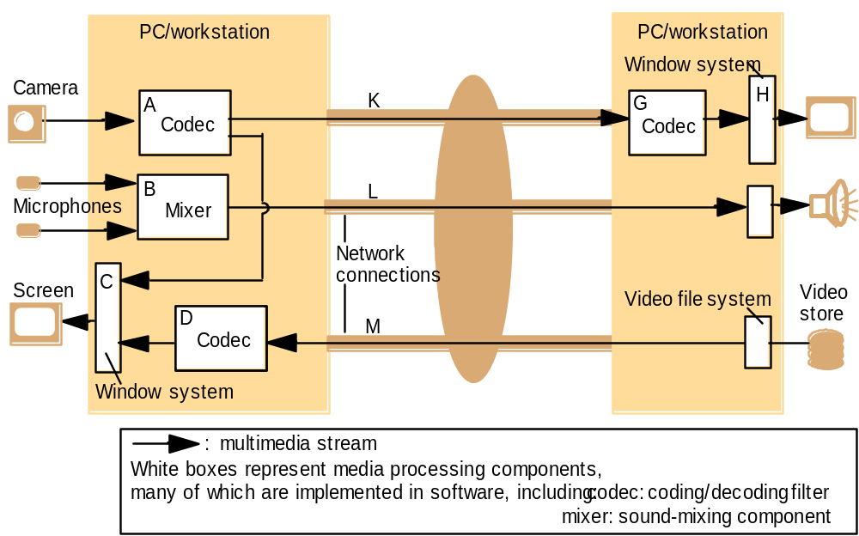
Typical infrastructure components for multimedia applications

Slide 8
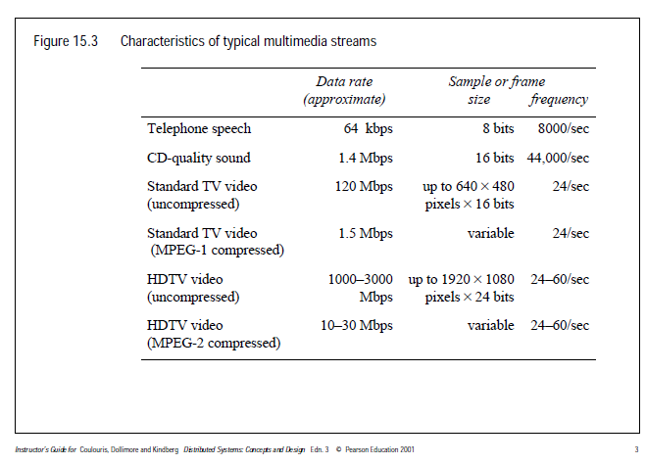

Slide 9
Media Delivery
Multimedia data is stored in the file system like other ordinary data.
However, multimedia data must be accessed with specific timing requirements.
For example, video must be displayed at 24-30 frames per second. Multimedia video data must be delivered at a rate which guarantees 24-30 frames/second.
Continuous-media data is data with specific rate requirements.

Slide 10
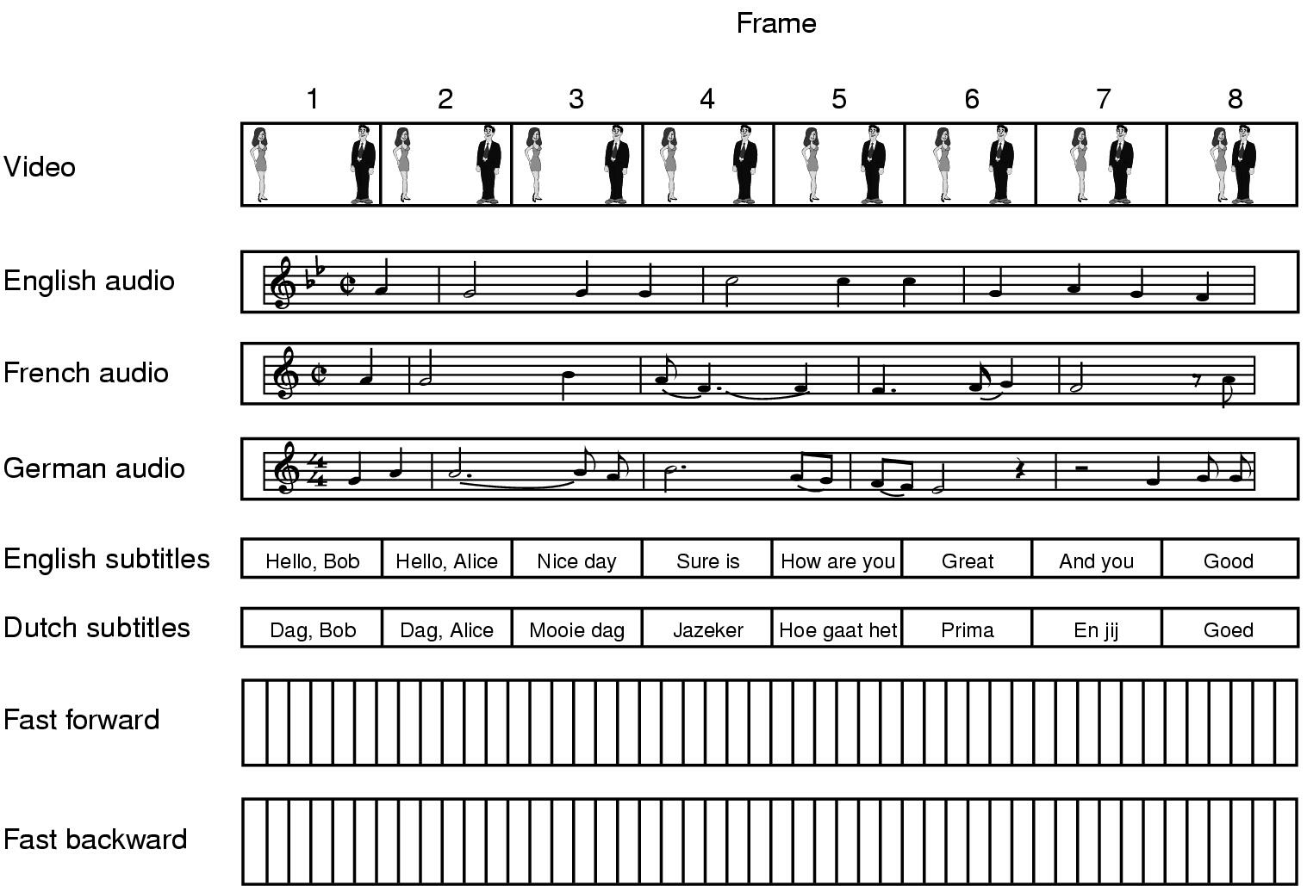
Multimedia Files
A movie may consist of several files

Slide 11
What is Streaming Technology
A technique for transferring data such that it can be processed as a steady and continuous stream, client does not have to download the entire file to view it.
Data
Source
Network
The portion in the buffer
The portion client is viewing

Slide 12
Streaming
There are two different types of streaming:
1. Progressive download - the client begins playback of the multimedia file as it is delivered. The file is ultimately stored on the client computer.
2. Real-time streaming - the multimedia file is delivered to - but not stored on - the client’s computer.
Notes:
http://www.onlinevideo.net/2011/05/streaming-vs-progressive-download-vs-adaptive-streaming/

Slide 13
Real-time Streaming
There are two types of real-time streaming:
(1) Live streaming - used to deliver a live event while it is occurring.
(2) On-demand streaming - used to deliver media streams such as movies, archived lectures, etc. The events are not occurring in real-time.

Slide 14
Forms of Streaming Media
Pre-stored media Its already been recorded and archived somewhere, when the user wants to access it we serve it as a stream
Live broadcast media The content is streamed as its produced (there may be a small editing / safety delay, as with traditional broadcasting) straight to the user
Live interactive media Such as videoconferencing - each user might produce their own stream, and that isn't control by one broadcaster

Slide 15
Advantages
It reduces download time
It provides steady service
Slower systems can take advantage of streaming technology
Provide service on demand
Applications are utilizing this technology are:
Streaming Video,
IP telephony, Internet Radio,
Distance learning,
Video Conferencing,
Interactive games and so on

Slide 16
Disadvantages
It is difficult to keep the service steady if the bandwidth is low
The maintenance of streaming server is relatively expensive
Packet loss may occur during the transmission

Slide 17
Multimedia Systems
Characteristics
Multimedia files can be quite large.
Continuous media data may require very high data rates.
Multimedia applications may be sensitive to timing delays.

Slide 18
Accessing Audio & Video Through a Web server
Web
Browser
HTTP
Web Server
With Audio
Files
Client
Files
Media
Player

Slide 19
Accessing Audio & Video Through a Meta File
Web
Browser
HTTP request /response
Client
for meta file
Web
Server
meta file
HTTP
Media
Player
Audio/Video file requested and sent using HTTP
A meta file contains information of URL, type of encoding, etc
about the audio/video file that is to be streamed.

Slide 20
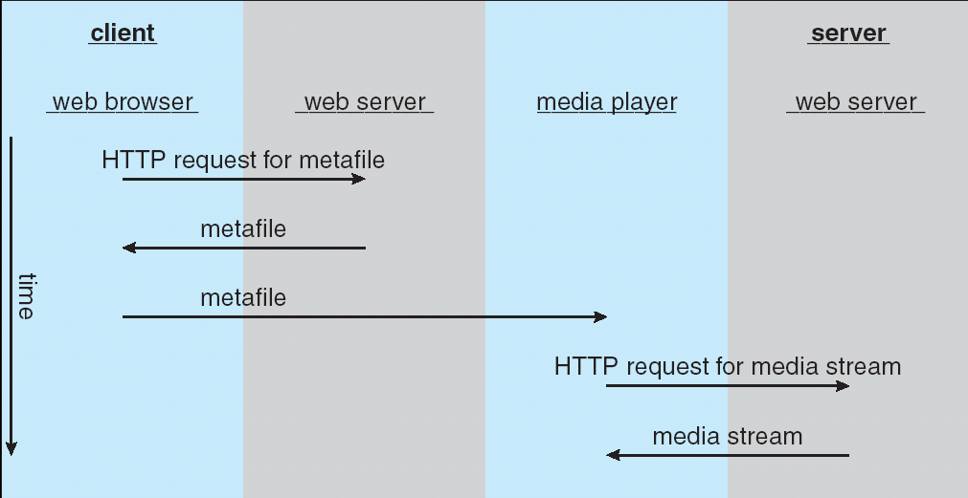
Streaming media from a conventional web server

Slide 21
RTSP Diagram
HTTP request/response
Web
Browser
Client
Web
Server
meta file
RTSP Streaming Command
Media
Player
Streaming
Server
RTP Audio / Video Content
HTTP is insufficient for user interaction. With streaming server
audio/video file can be sent over UDP,

Slide 22
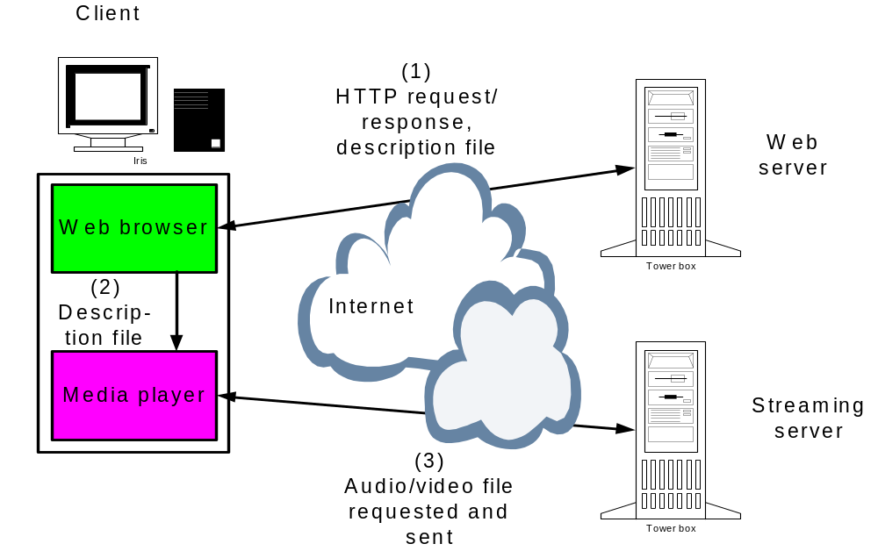

Slide 23
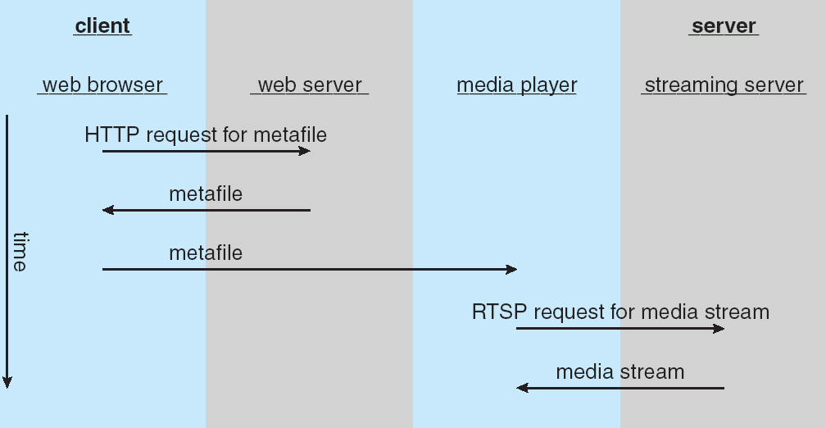
Real Time Streaming Protocol

Slide 24
Protocols used in Streaming Technology
Session Description Protocol (SDP)
Real Time Transport Protocol (RTP)
Real-time Control Protocol (RTCP)
Hypertext Transfer Protocol (HTTP)
Real Time Streaming Protocol (RTSP)

Slide 25
RTSP
RTSP is an industry standard Internet application level protocol
RTSP is a framework for delivering and transmission of multicast data stream
RTSP allows a media player to control the transmission of a media stream for exchanging control information
Another important function of RTSP is its ability to choose the optimum delivery channel to the client

Slide 26
RTSP Features
RTSP works in the conjunction with RTP to deliver streaming audio & video content
Standard HTTP is stateless whereby the server does not maintain the status of its connection with the client.
RTSP maintains a server state during transmission.
Limitations In Client-Server architecture
It Overcome the limitations of HTTP. RTSP enhance HTTP functions as well.
RTSP provides the synchronization of events

Slide 27
RTSP States
SETUP - The server allocates resources for a client session.
PLAY - The server delivers a stream to a client session.
PAUSE - The server suspends delivery of a stream.
TEARDOWN - The server breaks down the connection and releases the resources allocated for the session.

Slide 28
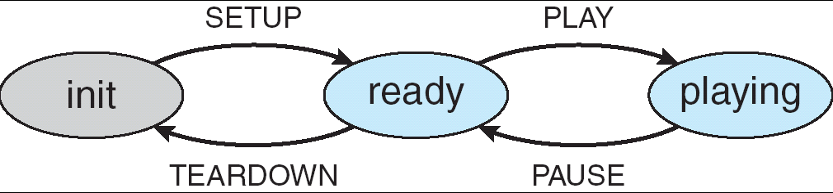
RTSP state machine

Slide 29
RTSP Operation
HTTP GET
Web
Browser
Web
Server
HTTP
Presentation Description File
Setup
Play
Media
Player
Media
Player
Media Stream
RTSP
Pause
Teardown

Slide 30
RTSP Media Player-Server Sequence Chart
User
Interface
RTSP
Player
RTSP
Server
OpenURL
SETUP
response1
PLAY
Activate
RTP
response2
Activate
RTP
audio
PAUSE
response3
Quit
TEARDOWN
response10

Slide 31
RTP
RTP is used to transmit real-time data
RTP encapsulate segments
Payload Sequence Timestamp Synchronization Misc
type number source identifier

Slide 32
RTP vs RTSP
It’s important to distinguish between RTP and Real-Time Streaming Protocol (RTSP), another transfer protocol.
RTSP is used when viewers communicate with a unicast server.
RTSP allows two-way communication; that is, viewers can communicate with the streaming server and do things like rewind the movie, go to a chapter, and so on

Slide 33
RTP vs RTSP
Quick Time automatically translates the viewer interaction with the on-screen movie controller into the proper RTSP requests.
By contrast, RTP is a one-way protocol used to send live or stored streams from the server to the client.

Slide 34
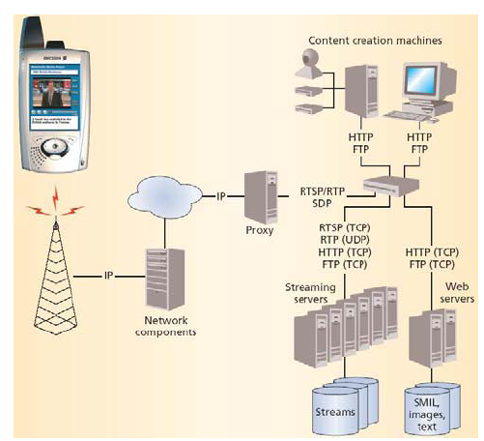
Streaming in Mobile Environments

Slide 35
RTSP Methods
Method DESCRIBE ANNOUNCE GET_PARAMETER OPTIONS PAUSE PLAY RECORD REDIRECT SETUP SET_ PARAMETER TEARDOWN | Description Retrieves the description of a presentation Posts the description of a presentation Retrieves the value of a parameter Queries the available methods Streams delivery is halted temporarily Starts sending data Starts receiving data Informs to connect another server location Specifies the transport mechanism Requests to set the value of a parameter Stops the stream delivery and frees the resources

Slide 36
The Data Compression Problem
Compression: Transforming the way information is represented
Compression saves:
  space (external storage media)
  time (when transmitting information over a network)
Types of compression:
  Lossless: the compressed information can be decompressed into the original information
    Examples: zip
  Lossy: the decompressed information differs from the original, but ideally in an insignificant manner
    Examples: jpeg compression

Slide 37
Compression
Because of the size and rate requirements of multimedia systems, multimedia files are often compressed into a smaller form.
MPEG Compression:
Stands for "Moving Picture Experts Group." The MPEG organization, which works with the International Organization for Standardization (ISO), develops standards for digital audio and video compression.
1. MPEG-1 - 30 frames/second
2. MPEG-2 - Used for compressing DVD and high-definition television (HDTV)
3. MPEG-4 - Used to transmit audio, video, and graphics. Can be delivered over very slow connections (56 Kbps)

Slide 38
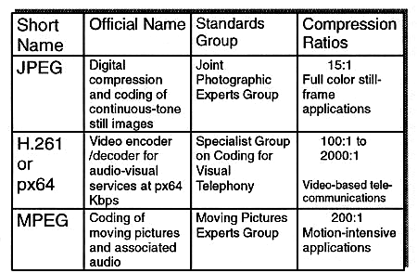
Compression Standards
Multimedia Compression

Slide 39
Operating Systems Issues
The operating system must guarantee the specific data rate and timing requirements of continuous media.
Such requirements are known as Quality-of-Service (QoS) guarantees.

Slide 40
QoS Guarantees
Guaranteeing QoS has the following effects in a computer system:
(1) CPU processing
(2) Scheduling
(3) File systems
(4) Network protocols

Slide 41
Requirement of Multimedia Operating Systems
There are three levels of QoS
(1) Best-effort service - the system makes a best effort with no QoS guarantees.
(2) Soft QoS - allows different traffic streams to be prioritized, however no QoS guarantees are made.
(3) Hard QoS - the QoS requirements are guaranteed.

Slide 42
Parameters Defining QoS
Throughput - the total amount of work completed during a specific time interval.
Delay - the elapsed time from when a request is first submitted to when the desired result is produced.
Jitter - Jitter refers to how variable latency is in a network.
Latency.
Reliability - how errors are handled during transmission and processing of continuous media.
Goodput.

Slide 43
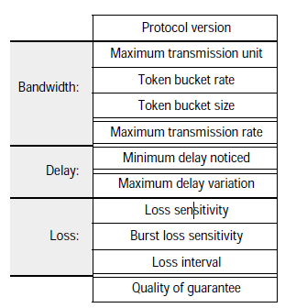
Flow Specifications
RFC 1363 defines QoS parameters:
  Bandwidth
  Latency and jitter constraints
  Data loss limits
  Token bucket size
Instructor’s Guide for Coulouris, Dollimore and Kindberg Distributed Systems: Concepts and Design Edn. 3 © Pearson Education 2001

Slide 44
Further QoS Issues
QoS may be negotiated between the client and server.
Operating systems often use an admission control algorithm that admits a request for a service only if the server has sufficient resources to satisfy the request.

Slide 45
CPU Scheduling
Multimedia systems require hard real time scheduling to ensure critical tasks will be serviced within timing deadlines.
Most hard real time CPU scheduling algorithms assign real time processes static priorities that do not change over time.

Slide 46
Disk Scheduling
Disk scheduling algorithms must be optimized to meet the timing deadlines and rate requirements of continuous media.
Earliest-Deadline-First (EDF) Scheduling
SCAN-EDF Scheduling

Slide 47
Disk Scheduling (cont)
The EDF scheduler uses a queue to order requests according to the time it must be completed (its deadline.)
SCAN-EDF scheduling is similar to EDF except that requests with the same deadline are ordered according to a SCAN policy.
The specific one that is first according to the scan direction is served first, among the remaining requests, this principle is repeated until no request with this deadline is left.

Slide 48
Network Management
Three general methods for delivering content from a server to a client across a network:
(1) Unicasting - the server delivers the content to a single client.
(2) Broadcasting - the server delivers the content to all clients, regardless whether they want the content or not.
(3) Multicasting - the server delivers the content to a group of receivers who indicate they wish to receive the content.

Slide 49
An Example: CineBlitz Multimedia Server
CineBlitz supports both realtime and non-realtime clients.
CineBlitz provides hard QoS guarantees to realtime clients using an admission control algorithm.
The disk scheduler orders requests using C-SCAN order.

Slide 50
YouTube, Serving Video
Each video is served by more than one machine and hosted by a mini-cluster..
Most popular content is moved to a CDN (content delivery network)
Less popular content (1-20 views per day) uses YouTube servers in various proper sites
Videos come out of any data center. Not closest match or anything. If a video is popular enough it will move into the CDN.

Slide 51
The End

